Slide 1

Skills Academy
Autumn 1 2026

Slide 2

Skills Academy
Don’t forget to fill in your
Skills Academy log sheet.
2026-2027
Name:
Class:
Autumn 1
Autumn 2
Spring 1
Spring 2
Summer 1
Summer 2
A different club each half term
Name of club
Name of club
Name of club
Name of club
Name of club
Name of club
Try to choose a club from a different category from last time. Physical, Creative and Academic

Slide 3





Rewards
In each club, we will give out
x1 Respect, x1 Responsibility and
x1 Resilience postcard each week.
REMIND YOUR TEACHERS
POSTCARDS
At the end of the year, all children who have chosen a different club each half term and have at least one from each category will take part in a special fun day.
FUN DAY

Slide 4
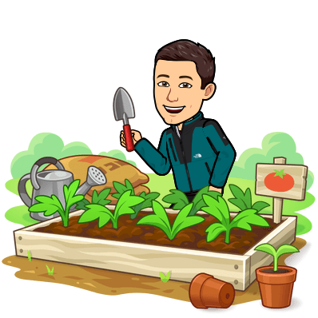





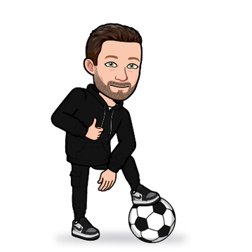
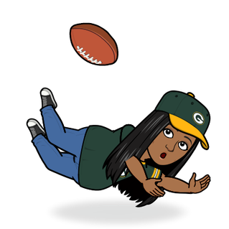
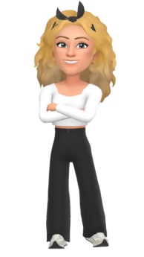
Autumn 1 Physical Clubs
Forest School
Mr Hancock
Girls’ Football Y5/6
Mini Trampolining
Mr Stevens
Walking & Talking
Mrs Flint & Miss Jarvis
Mr Taylor
Dance
Mr Burgess
Big Games
Pool and Darts
Boys’ Football Y5/6
Mrs Johnson
Mrs Smith

Slide 5
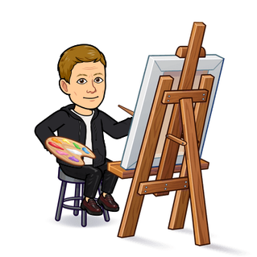



Autumn 1 Creative Clubs
Mrs Gallagher
Art
Creative Cultures
Mrs Emslie
Mr Bolus
Creative Club
Loom Bands Club
Miss Barrett
Fashion Design
Mrs Smith

Slide 6

Autumn 1 Academic Clubs
Lego Club
11+ Club
Mr Woodward
Miss Richards

Slide 7
Extra information before you choose....
https://ernesfordgrangeprimary.com/category/skills-academy/

Slide 8
END

Slide 9

Blogging and Vlogging: Think social media take over. You’ll document the fun we have at EGPS on our blogging platform by interviewing your friends, taking photos and writing captions.
Miss Appleton

